Slide 1

Activation Function

Slide 2


Controls Neuron’s Output
Controls Neuron’s Learning

Slide 3
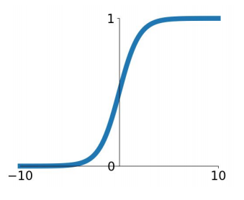
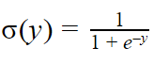
Sigmoid Function
Squashes output between 0 and 1
Nice interpretation i.e neuron firing or not firing
It has 3 problems.

Slide 4
Sigmoid Function
Problem 1
Vanishing Gradient
Derivative is zero when x> 5 or x <-5
Weights will not change
No Learning

Slide 5
Sigmoid Function
Problem 2
Output is not Zero-centered
Only positive numbers to Next layer

Slide 6
Sigmoid Function
Problem 3
e^{y} is compute expensive

Slide 7
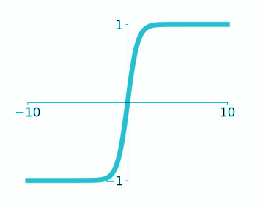
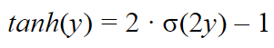
tanh
1. Zero-centered
2. Vanishing gradient
3. Compute expensive
hyperbolic tangent

Slide 8
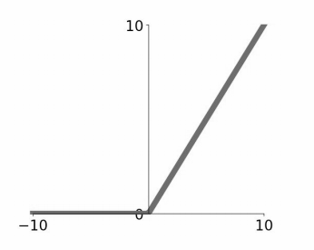
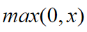
Rectified Linear Unit (ReLU)
1. Does not kill gradient (x>0)
2. Compute inexpensive
3. Converges faster
4. No Zero-centered output

Slide 9
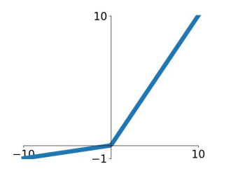
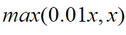
Leaky ReLU
1. Does not kill gradient
2. Compute inexpensive
3. Converges faster
4. Somewhat Zero-centered

Slide 10

Which activation function we should use?

Slide 11

Use ReLU
Try out Leaky ReLU
Try out tanh but don’t expect much
Minimize use of Sigmoid

Slide 12


Memorizing
vs
Learning

Slide 13
How do we know machine is really learning or memorizing?
By looking at test accuracy (or loss) and comparing it with training accuracy/loss.

Slide 14
Overfitting
Training Accuracy
Model Accuracy
Big Gap
Test Accuracy
Number of iterations

Slide 15
How do we avoid overfitting?
By getting more data, we can make machine reduce overfitting. But quite often it's not easy to get additional data.

Slide 16

Dropout
...refers to dropping or ignoring neurons at random to reduce overfitting.

Slide 17
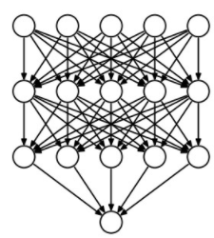
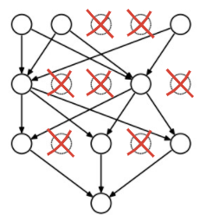
Dropout
A regular Dense Neural Network
Dense neural network with ‘Dropout’

Slide 18
How to apply dropout?
Dropout 40%
Usually applied to output of hidden layers.
Apply dropout to all or some of the hidden layers.
Dropout rate (% of neurons to be dropped) can be specified for each layer individually.
Generally dropout is used only during training i.e No neurons get dropped during prediction.
Dropout 60%
Dropout 50%

Slide 19
model.add(tf.keras.layers.Dropout(0.4)
Applying Dropout
model.add(tf.keras.layers.Dense(200))
model.add(tf.keras.layers.Dropout(0.5))
model.add(tf.keras.layers.Dense(100))
model.add(tf.keras.layers.Dropout(0.4))

Slide 20

Batch Normalization

Slide 21
How do we normalize data?
There are two approaches which are common in Machine Learning

Slide 22
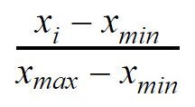
1. Min-Max Scaler
Feature value is between 0 and 1 after normalization

Slide 23
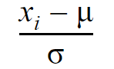
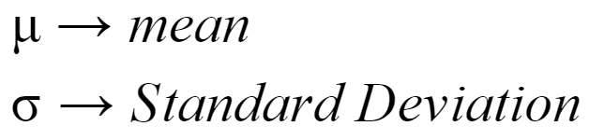
2. z-Score Normalization
Mean is 0 and Variance is 1 after normalization

Slide 24

When do we normalize data in ML?
We usually normalize the data and then feed it to the model for training.

Slide 25
Deep Learning models have multiple trainable layers
Normalizing data before model training allows 1st hidden layer to get normalized inputs, but ...
Other trainable layers may not get normalized input
How do we allow different trainable layers in Deep Learning model to get normalized data?

Slide 26
Batch Normalization
Implementing data normalization for deeper trainable layers

Slide 27
model.add(tf.keras.layers.BatchNormalization())
We can use BatchNormalization layer to normalize data before any trainable layer
model.add(tf.keras.layers.Dense(200))
model.add(tf.keras.layers.BatchNormalization())
model.add(tf.keras.layers.Dense(100))
model.add(tf.keras.layers.BatchNormalization()

Slide 28
What type of normalization will BatchNorm layer do?
z-Score Normalization

Slide 29
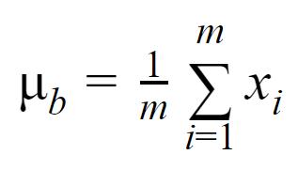
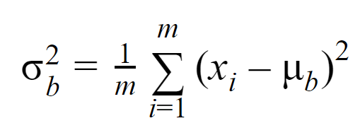
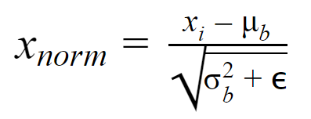
Ops in Batch Normalization
1. Calculate mean or average for each feature in a batch
2. Calculate Variance for each feature in the batch
3. Normalize each feature using mean and standard deviation
4. Adjust average and variance for a feature across batches
For each feature, BatchNorm layer will calculate two parameters i.e mean and variance

Slide 30
So BatchNorm layer works exactly like a z-Score normalization?
Well, not exactly!
It also allows machine to further modify the normalized feature value using two learnable parameters.

Slide 31
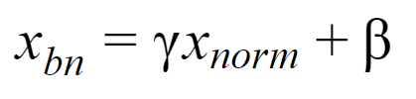
Ops in Batch Normalization
5. Scale and Shift
Learned by machine
Final normalized value
For each feature, BatchNorm layer will have two trainable parameters.

Slide 32

Where to use BatchNorm?
Apply it before a trainable layer.
Apply it to all or some of the trainable layers.
Significant impact on reducing overfitting.
Can be used with or inplace of Dropout
Use BatchNorm as much as possible to improve your Deep neural networks.

Slide 33

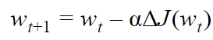
Learning Rate

Slide 34
What is a good learning rate?

Slide 35
Visualizing Learning Rate
Very high rate
Loss
Low rate
High rate
Good rate
Number of iterations

Slide 36
Learning rate decay

Slide 37

We usually reduce learning rate as model training progresses to reduce chances of missing minima.

Slide 38
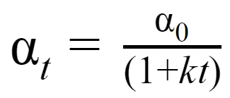
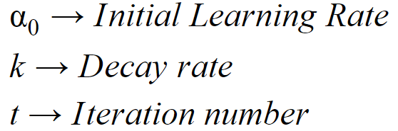
Time based learning rate decay
sgd_optimizer = tf.keras.optimizers.SGD(lr=0.1, decay=0.001)
model.compile(optimizer=sgd_optimiser, loss='mse’)

Slide 39

Optimizers

Slide 40
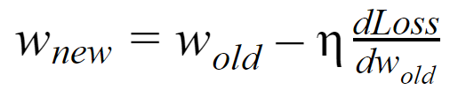
Learning Rate
Stochastic Gradient Descent (SGD)
Key to improving machine’s learning

Slide 41

Sometimes it may not work well...

Slide 42
Loss function is usually quite complex
Loss
Let’s review on how Gradient Descent will change ‘W’ for this scenario
W

Slide 43
Starting position
Gradient Descent will increase W to reduce loss
Loss function is usually quite complex
. . . increase ‘w’ again
. . . increase ‘w’ again
Loss
What happens at this point?
Let’s review on how Gradient Descent will change ‘W’ for this scenario
W

Slide 44
Starting position
Gradient Descent will increase W to reduce loss
Loss function is usually quite complex
. . . increase ‘w’ again
. . . increase’ w again
Loss
What happens at this point?
‘W’ does not increase as Gradient is positive
Let’s review on how Gradient Descent will change ‘W’ for this scenario
W

Slide 45
Starting position
Gradient Descent will increase W to reduce loss
. . . reduce ‘w’ again
Problem with SGD
. . . reduce ‘w’ again
SGD will get stuck
Can not find better local minima
Such scenarios quite common in Deep Neural Networks
Loss
What happens at this point?
‘W’ does not increase as Gradient is positive
W

Slide 46
Another scenario
What happens at this point?
Zero gradient
SGD gets stuck
Loss
Saddle point
W

Slide 47
How do we overcome local minima & saddle points?
Bringing Physics to ML

Slide 48
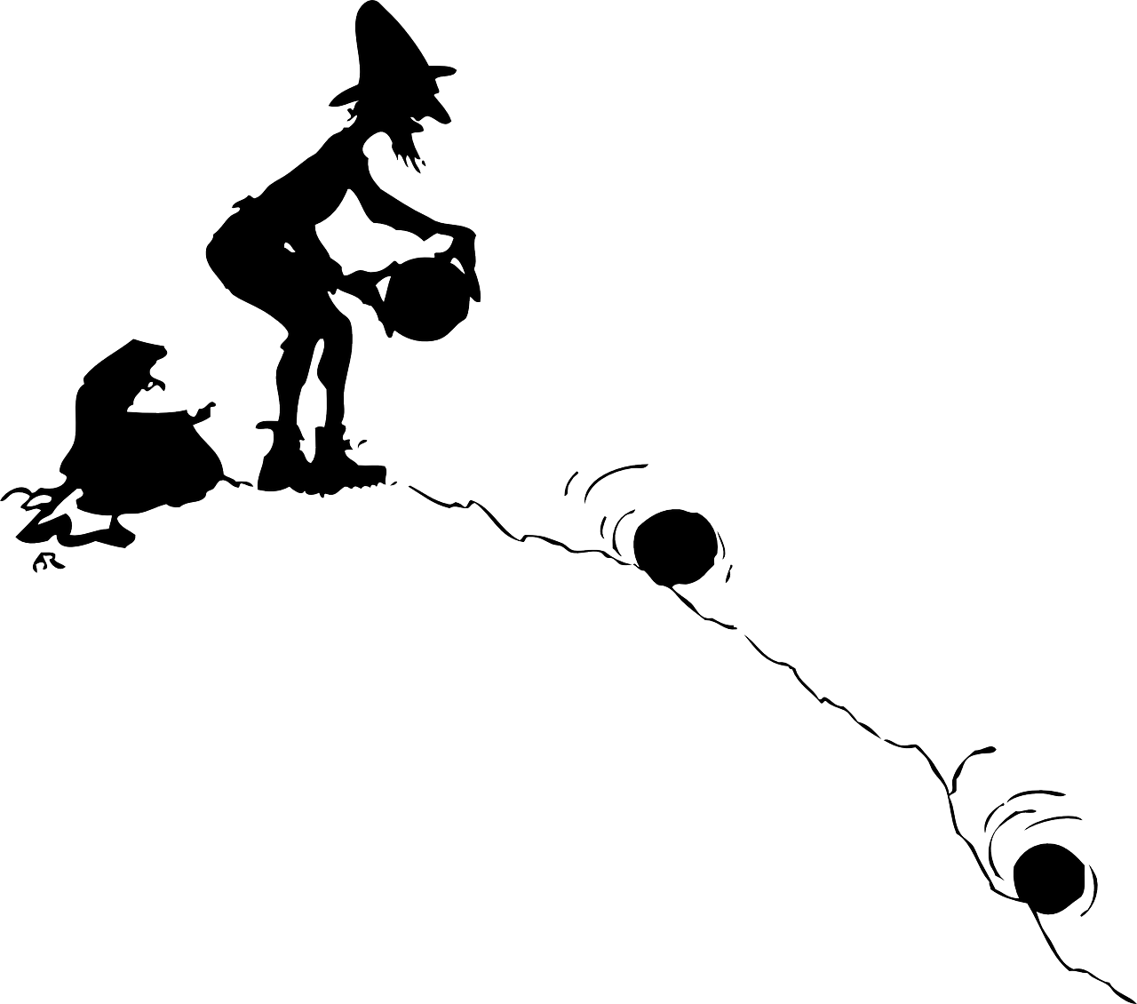
Momentum
Using physics in ML
When a ball rolls down the hill …
it gains in momentum due to gravity.
ball moves faster and faster .
Can overcome small hurdles
We can use similar approach in ML to change weights and bias.

Slide 49
How do we use momentum with weight changes?

Slide 50
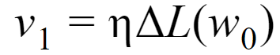
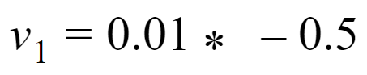
Starting position
Amount of change in W for step 1
GD will increase W to reduce loss
Let’s take an example
Loss
Step 1
W

Slide 51
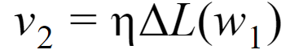
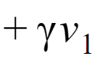
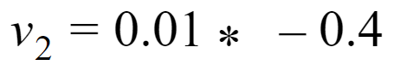
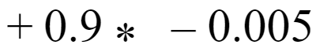
Starting position
Amount of change in W for step 2 with momentum
Change in W without momentum
Change in W with momentum
A percent (say 90%) of change from step 1
Loss
Step 2
W

Slide 52
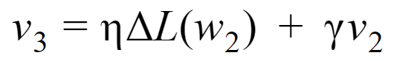
Starting position
Amount of change in W for step 3 with momentum
Change in W with momentum
A percent (say 90%) of change from step 2
Loss
Step 3
W

Slide 53
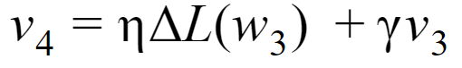
Starting position
Amount of change in W for step 4 with momentum
Change in W with momentum
Although gradient is ‘+’ at step 4 but gradient from previous step will allow machine to increase ‘W’
Loss
Step 4
W

Slide 54
Gradients from all the past steps (in addition to current step) are used to calculate final gradient at a step.
Time step 1
Time step 2
Time step 3
Momentum
Time step 4

Slide 55
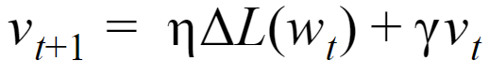
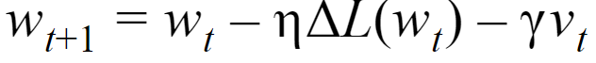
SGD with Momentum
Gradient with Momentum
momentum
New weight

Slide 56
Implementing
SGD with Momentum
sgd = tf.keras.optimizers.SGD(lr=0.03, momentum=0.9)

Slide 57
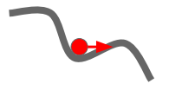
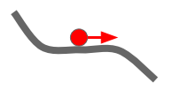
What happens to Saddle point and local minima?
Momentum gain will allow machine to overcome these scenarios

Slide 58
Can that be a problem?
Momentum ‘may’ allow machine to go too far away from minima from where it can not come back

Slide 59
How do we overcome such situations?
If we are coming down a hill, we gain momentum because of gravity.
But as we get closer to our destination, we try to reduce speed not to overshoot our destination.
We can take action as we are able to see what’s coming up.

Slide 60
Can Machine check what’s in future?
This means to check if loss will increase or decrease in future...

Slide 61
How do Check change in loss in future?
By calculating Loss gradient w.r.t to future weight

Slide 62
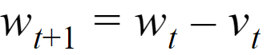
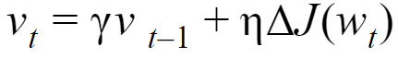
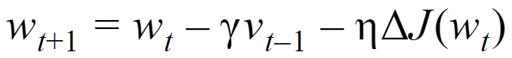
How to get future weight?
Gives us some idea about future i.e what will be the weight at the following step (at t+2)

Slide 63
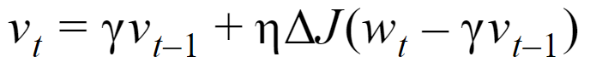
SGD with Nesterov Momentum
Gradient of loss is not calculated wrt w_{t}.
Rather, loss gradient is calculated wrt to ‘w_{t} - ४v_{t-1} ’ i.e future weight
Adjusted Momentum

Slide 64
Implementing
SGD with Nesterov Momentum
sgd = tf.keras.optimizers.SGD(lr=0.03, momentum=0.9, nesterov=True)
SGD with Nesterov momentum and learning rate decay is a very popular optimizers to train modern architectures.

Slide 65

We use same learning rate all the weights

Slide 66
Another weight with much slower change in Loss
Loss
Loss
W₁
A weight with much faster change in Loss
W₂

Slide 67
Here, it might be better to reduce amount of changes to ‘W’ by reducing the learning rate
Another weight with much slower change in Loss
Loss
Loss
For this weight, we can apply a higher learning rate to change W with higher amount to speed up the learning
W₁
A weight with much faster change in Loss
W₂

Slide 68
How do use different learning rates for different weights?
We can use gradient values of the past step
...but in a different way then momentum

Slide 69
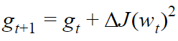
How should we measure past gradients?
Add Squared Gradient to past Gradients
If a weight has faster loss change...i.e higher gradients in the past then this term will be HIGH
If a weight has slower loss change...i.e smaller gradients in the past then this term will be LOW

Slide 70
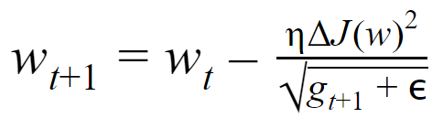
Adagrad
Adapts or changes learning rate for each weight
Learning Rate is different at each step for each weight
Use g_{t+1} to calculate effective learning rate

Slide 71
Implementing Adagrad
model.compile(optimizer=’adagrad’, loss=. . ., metrics=[‘accuracy’])

Slide 72
Adagrad
Advantage
No need to adjust Learning Rate
Disadvantage
Learning Rate is always decaying

Slide 73
Loss
Consider this scenario
W₁

Slide 74
How do we avoid always decaying learning rate in Adagrad?
Do not consider gradients for all the past steps… rather focus more on recent ones. ..
If in the recent past gradients were high then learning rate will be low
If later, the gradients reduce then we can use higher learning rate (for the same weight)

Slide 75
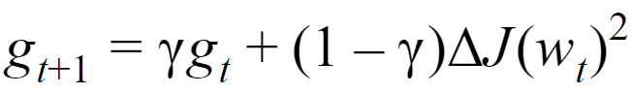
AdaDelta
Uses decaying mean to reduce influence of gradients from long back
Decaying mean of Squared Gradients
Gamma controls how much weightage is given to past gradients and current gradient. A value less than 1 ensures that impact of gradients from earlier steps is always decaying.

Slide 76
AdaDelta
Uses decaying mean to reduce influence of gradients from long back
As past gradients are decaying, the denominator can increase (as in adagrad) or decrease (increasing effective learning rate)

Slide 77
Anything else we can do?
Using approach of both momentum and Adadelta together . . .

Slide 78
Keeps track of past Squared Gradients (like Adadelta)
Keeps track of past Gradients (like momentum)
Adam
Adaptive Moment Estimation

Slide 79
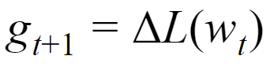
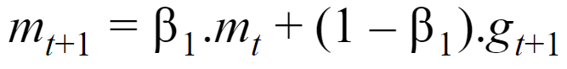
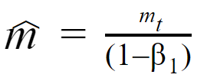
Calculate Gradient
Adam
Tracking decaying mean of past gradients
Decaying mean of past Gradients
(First Moment)
Bias-corrected First moment

Slide 80
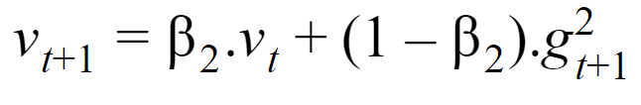
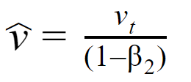
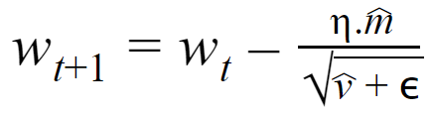
Second moment, past squared Gradients
Adam
Tracking decaying mean of past squared gradients
Bias-corrected Second moment
New Weight

Slide 81
Adam
New Weight

Slide 82
Adam
Advantage
Removes the need to tune Learning rate
(just set an initial learning rate)
Adam (along with SGD with momentum) is top choice for optimizers in Deep Learning

Slide 83
Implementing Adam
model.compile(optimizer=’adam’, loss=’categorical_crossentropy’, metrics=[‘accuracy’])

Slide 84
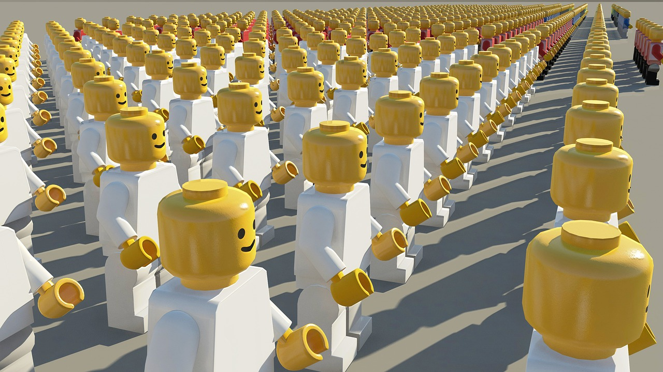
1. Adam
2. SGD with nesterov momentum
3. RMSProp or Adadelta
4. Adagrad
5. Vanilla SGD
Which Optimizer to prefer?

Slide 85
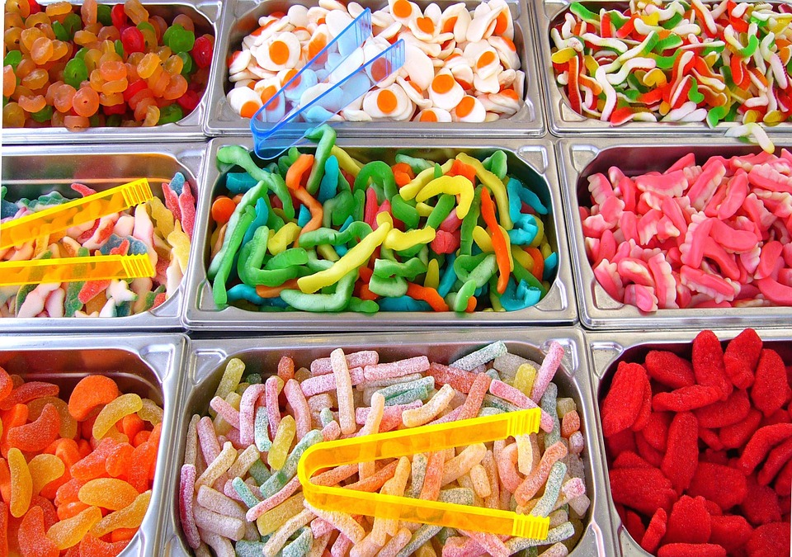
Hyperparameters
in
Deep Learning

Slide 86
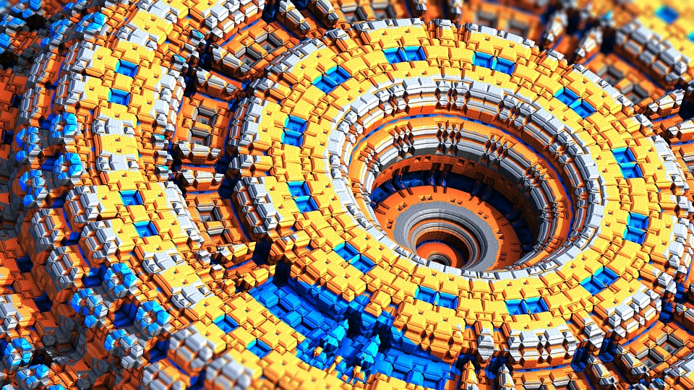



# of iterations
Batch Size
Learning Rate
Learning rate decay
# of Hidden Layers
# of Neurons in each Layer
Activation functions
Dropout
Batch Normalization
Optimizers

